Slide 1
Neighbourhood Exploration
Toronto
By Waseem Anjum

Slide 2
Problem Statement
To recommend the best neighborhood to live, to buy a house, to rent an apartment or build a restaurant etc in Toronto.
To understand the similarities and differences between the neighborhoods using Unsupervised K-Mean Clustering Algorithm.

Slide 3
Objective
Collecting the top trending venues in the using Foursquare API(Beautiful Soup, http request)
Forming neighborhood clusters based on venue categories using unsupervised k-mean clustering algorithm(sklearn)
Identifying and understanding the similarities and differences between two chosen neighborhoods to retrieve more insights and to conclude which neighborhood wins over other.

Slide 4
Work flow
Web Scraping and Data Wrangling
Top Trending Places Extraction and Clustering
Decision Making based on the clustered neighborhoods, Population Distribution, School Ratings, Median House Price Analysis

Slide 5
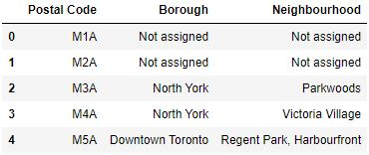
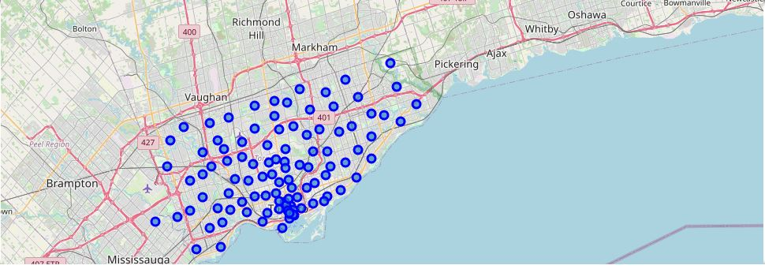
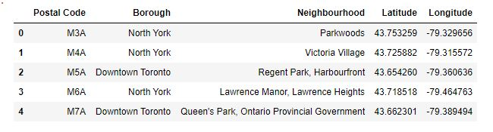
Beautiful Soup to collecting data from following link
https://en.wikipedia.org/w/index.php?title=List_of_postal_codes_of_Canada:_M&oldid=995657573
Collected Geospatial data & merge the table
https://cocl.us/Geospatial_data'
Folium visualization for Toronto Neighbourhood

Slide 6
Four Square API Calls to Collect Neighborhood Venue Category and LAT/LNG
One Hot Encoding to Convert Labels into Numbers
Venues Grouped by Neighborhood 100 Unique Venues
K-Means Clustering
Cluster 1
Cluster 2
Cluster 3

Slide 7
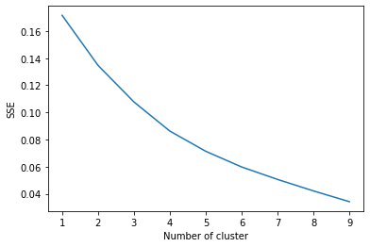
Elbow Criterion Method Elbow method is to run k-means clustering on a given dataset for a range of values of k and for each value of k and calculate sum of squared errors (SSE).

Slide 8
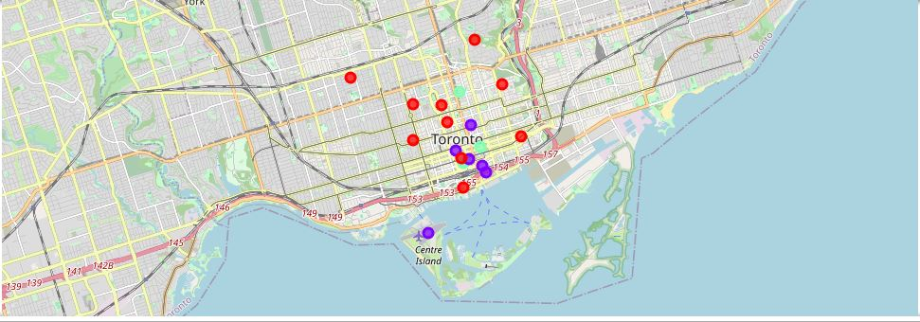
Cluster Neighbourhood

Slide 9
sklearn.metrics.silhouette_score
The Silhouette Coefficient is calculated using the mean intra-cluster distance (a) and the mean nearest-cluster distance (b) for each sample.
The formula for the Silhouette Coefficient of a sample is
(b - a) / max(a, b).
The best value is 1 and the worst value is -1. Values near 0 indicate overlapping clusters. Negative values generally indicate that a sample has been assigned to the wrong cluster.

Slide 10

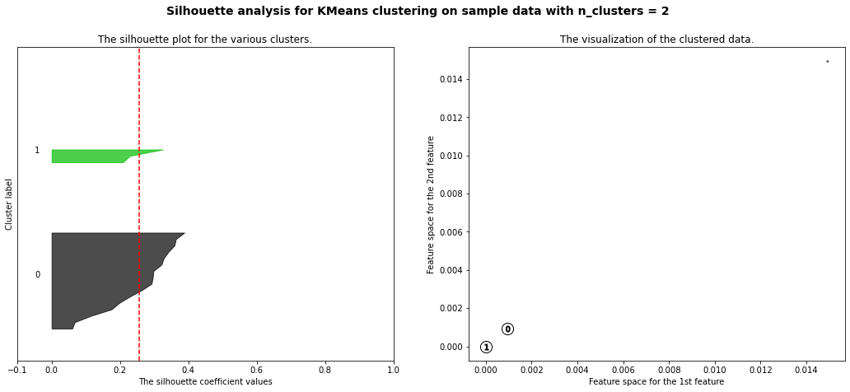
Siluhouette Score and Cluster Visualization

Slide 11
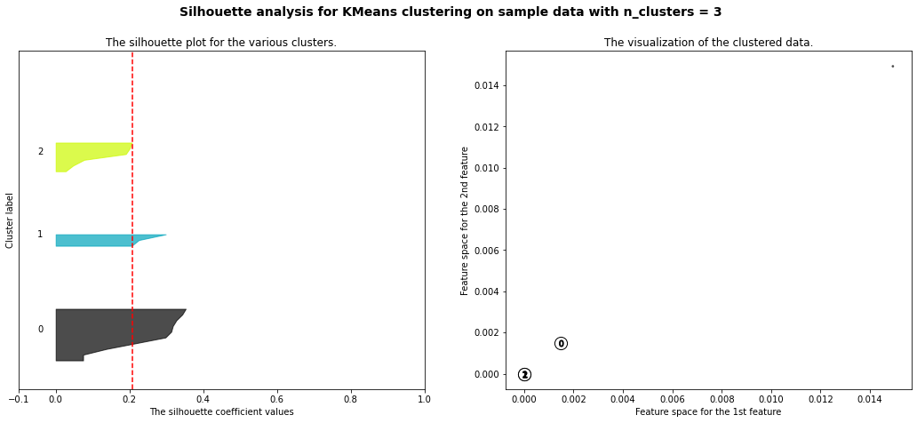
Siluhouette Score and Cluster Visualization

Slide 12
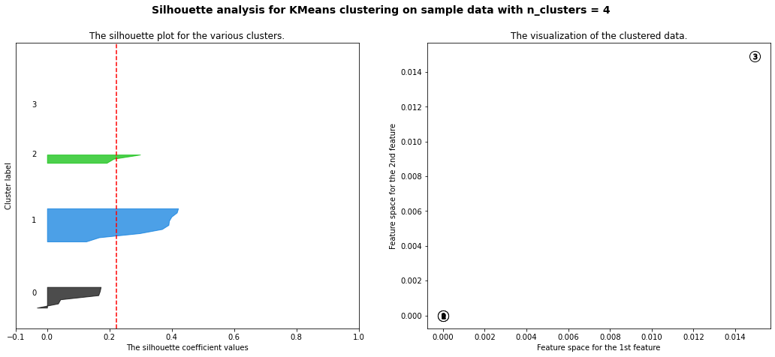
Siluhouette Score and Cluster Visualization

Slide 13
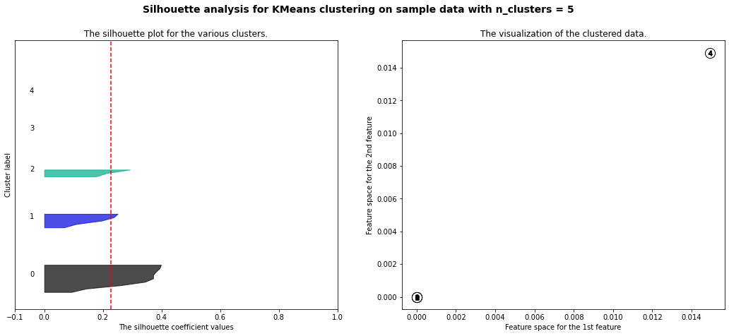
Siluhouette Score and Cluster Visualization

Slide 14
Decision making
Neighbourhood 1
Neighbourhood 2
Population Distribution analysis
School Ratings Analysis
Median House Price Analysis
Cluster Analysis
Decided

Slide 15
Comparison Between Neighbourhoods
Now lets compare 2 neighborhoods to choose one that best matches our requirements as given below
1. More Indian Population
2. Higher School Rating
3. Reasonable Housing Price in the Range of 300k to 500k
4. Comfortable Neighborhoods

Slide 16
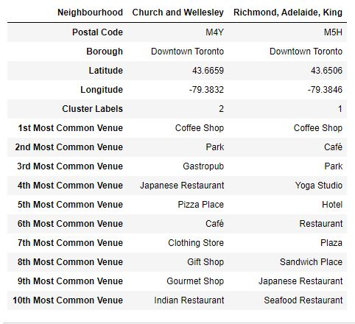
Neighbourhood Venues

Slide 17
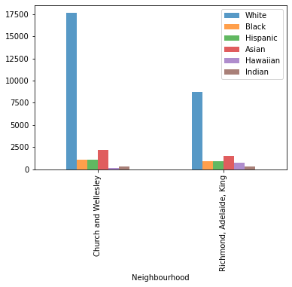
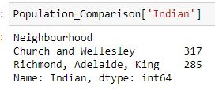
Population Distribution

Slide 18
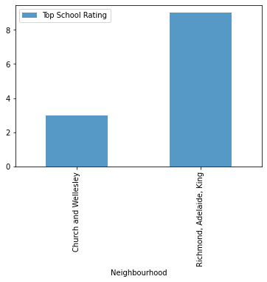
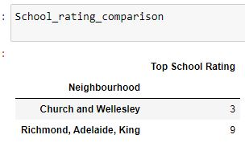
School Ratings

Slide 19
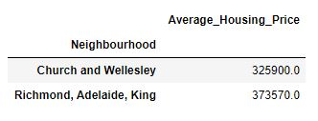
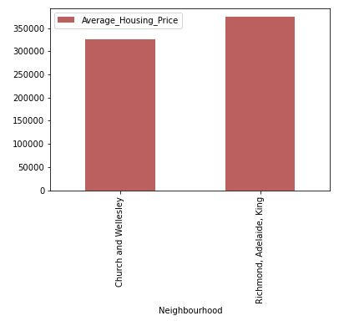
Average Housing Price

Slide 20
Conclusion
This Analysis concludes that compared to Bellevue ,
Richmond has the higher number of population (including Indians)
Good school rating of 9
Reasonable average housing price of approximately 330k
also top 10 common venues shows Richmond has got a good neighborhood with Park, Cafe and coffee shop Restaurants, Train Station, Clothing Store, Donut Shop and many more.
Hence Richmond sounds better than other one comparing of these 2 neighbourhood

Slide 21
Thanks you

